Slide 1
Digital Portfolio
STUDENT NAME: VISHAL S
REGISTER NO AND NMID: A1AF11C1C546EB0A4474DC866BC8AA0B
DEPARTMENT:
COLLEGE: COLLEGE/ UNIVERSITY : SHANMUGA INDUSTRIES ARTS AND SCIENCE COLLEGE, TIRUVANNAMALAI

Slide 2

PROJECT TITLE
“Responsive Web Developer Portfolio Website”

Slide 3


AGENDA
Problem Statement
Project Overview
End Users
Tools and Technologies
Portfolio design and Layout
Features and Functionality
Results and Screenshots
Conclusion
Github Link
3/21/2024 Annual Review

Slide 4

PROBLEM STATEMENT
Clearly define the problem you`re solving
Example: “Fresh graduates often lack a professional online presence to Showcase their skills and projects, making it harder to stand out in job applications”

Slide 5

PROJECT OVERVIEW
Give a short description of your portfolio project
Example: “This project is a personal portfolio website that highlights my skills,
projects, certifications and contact details in a professional and user- friendly manner.”

Slide 6

WHO ARE THE END USERS?
Who will benefit from your project?
Example:
Recruiters/Hiring managers
Clients/Companies
Peers and collaborators

Slide 7
TOOLS AND TECHNIQUES
List all tools and tech stacks used.
Example:
Frontend:HTML,CSS,JavaScript
Styling :Bootstrap/Tailwind CSS
Backend :Node.js ,PHP
Database: MySQL,MongoDB
Version Control: Git,GitHub

Slide 8
POTFOLIO DESIGN AND LAYOUT
Protfolio Design and Layout
Example sections:
» Home(Intro + banner)
» About Me
» Skills
» Projects
» Contact Form
» Resume Download
8

Slide 9
FEATURES AND FUNCTIONALITY
Responsive Design
(works on mobile,tablet,desktop)
Interactive navigation
Contact form(with email integration)
Project showcase with GitHub Links
Downloadable resume

Slide 10
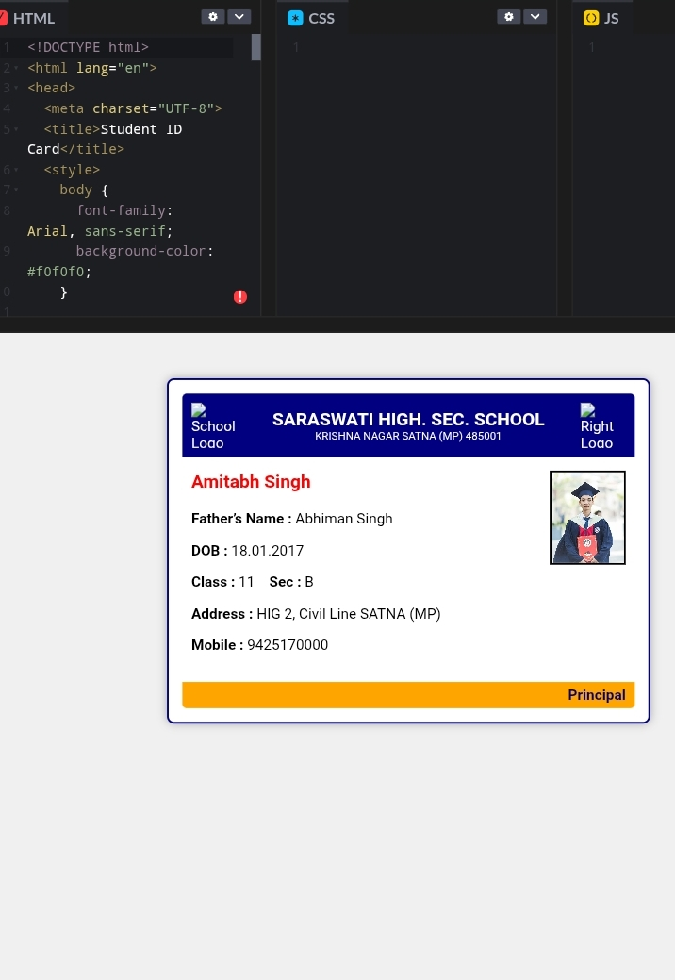
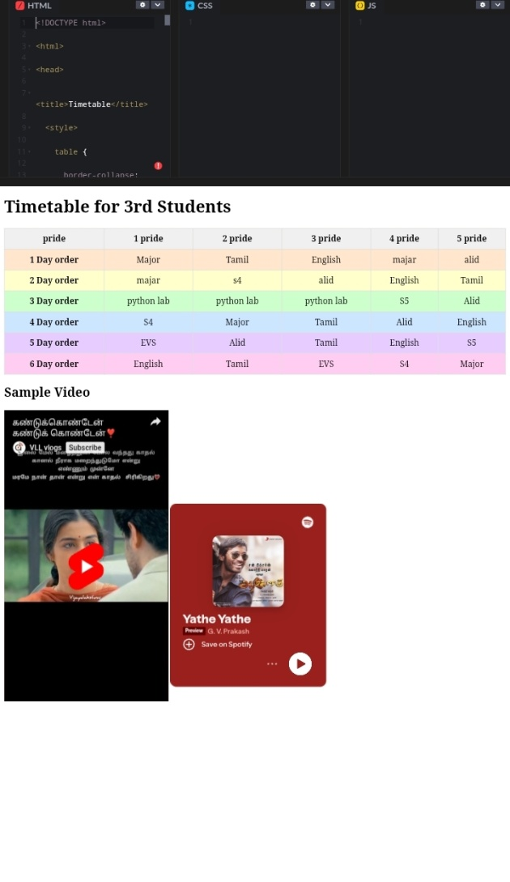

RESULTS AND SCREENSHOTS
3/21/2024 Annual Review
10

Slide 11
CONCLUSION
Summarize your learning & outcomes
Example:
“ This portfolio enhances my professional visibility,
helps recruiters view my projects,and demonstrates my web development skills in real- time ”.
11

